Slide 1
Pattern Fragility
Several ways to destroy Strategy

Slide 2
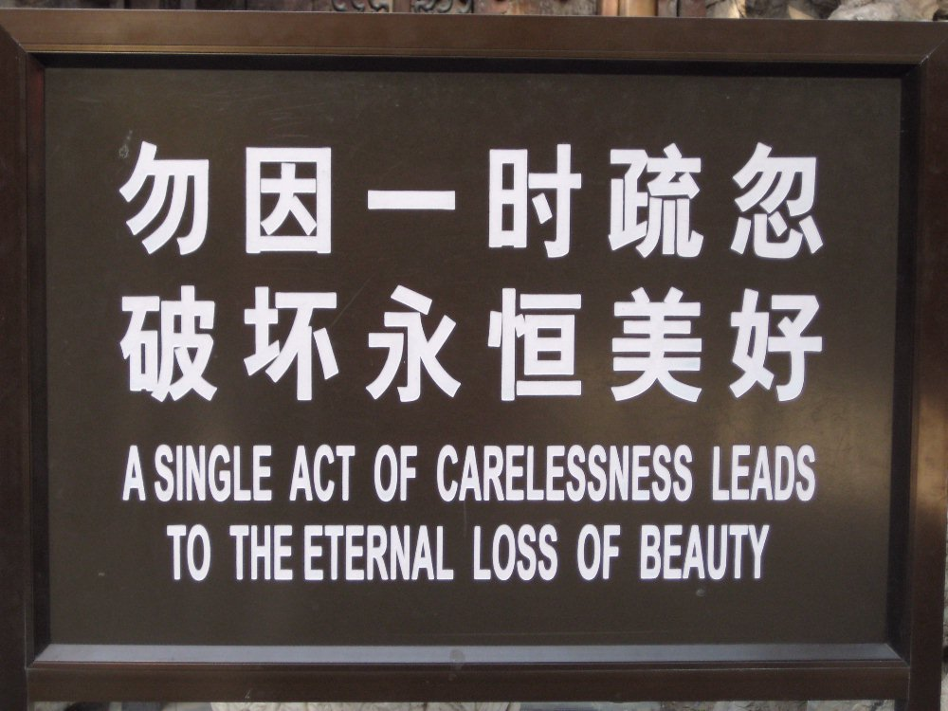
Advice
Forbidden city, Beijing.

Slide 3
Why Patterns?
Design patterns organize and structure code in a particular way.
  Static: Arrangement of classes/interfaces
  Dynamic: Assignment of responsibility, interaction patterns
Why:
  Because I get some benefits from doing so
Bottom line:
  Patterns are means to a goal, not the goal itself
© Henrik Bærbak Christensen

Slide 4
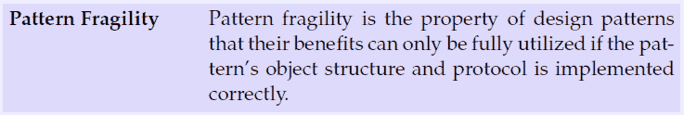
Patterns Are Code
However, patterns are defined in code, and if I code wrong I “amputate” the pattern. I get all the liabilities and none of the advantages.
Warstory:
  COT case: Reusable search component’s deadline was forced. Additional staff added. A design pattern based, highly decoupled, design was utterly destroyed in a week.
© Henrik Bærbak Christensen

Slide 5
Example: Strategy

Slide 6
Strategy
Responsibilities must be served by concrete behaviour in objects...
<<interface>>
PayStation
<<interface>>
RateStrategy
LinearRateStrategy
ProgressiveRateStrategy
© Henrik Bærbak Christensen

Slide 7
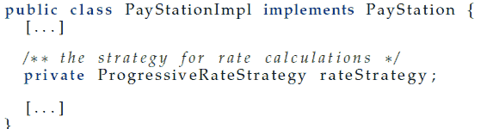
Pitfall 1: Declaration of Delegates
1. Do not even think of using class names in declarations!
Why is the following change a disaster
© Henrik Bærbak Christensen

Slide 8
Proverb 1
Declare object references that play part in a design pattern by their interface type, never by their concrete class type.
© Henrik Bærbak Christensen

Slide 9
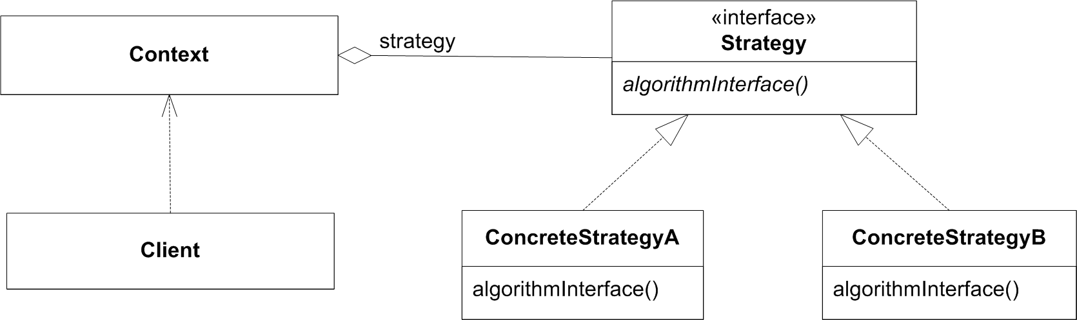
Pitfall 2: Binding in the Right Place
Loose coupling is fine, but we have to couple the objects together eventually.
It is important that the binding is made
  in the right place
  as few places as possible (optimally 1!)
Many possibilities for Strategy:
Why not here???
© Henrik Bærbak Christensen

Slide 10
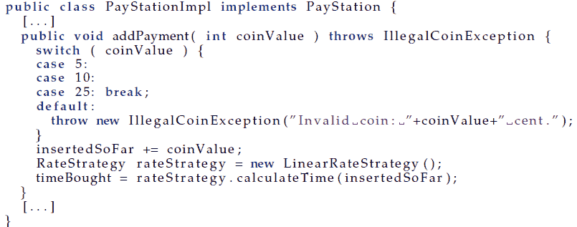
Binding in the Wrong Place
Binding in the Context object:
Will not break any tests for Alphatown!
© Henrik Bærbak Christensen

Slide 11
Consequence
What is the consequence?
I got all the pattern’s liabilities
  more interfaces and classes and objects to overview
And none of the pattern’s benefits
  high coupling
  no variability at all!
© Henrik Bærbak Christensen

Slide 12
Advice
Proverb
Object should be created and coupled in the production code units whose responsibility are explicitly configuration and binding.
In Strategy, this is normally the Client role.
Note again:
  Automated tests that test the full suite of products will detect this defect.
  A manual testing effort much focused on a specific product variant will probably not...
© Henrik Bærbak Christensen

Slide 13
Relation to Other Patterns
Abstract Factory is a creational pattern. Its purpose in life is to define bindings. Thus, the factory is often the right place to make bindings.
In State it is actually often the ConcreteState objects that define the ‘next state’ of the state machine. Thus it is more common that ConcreteState objects directly create state objects.
© Henrik Bærbak Christensen

Slide 14
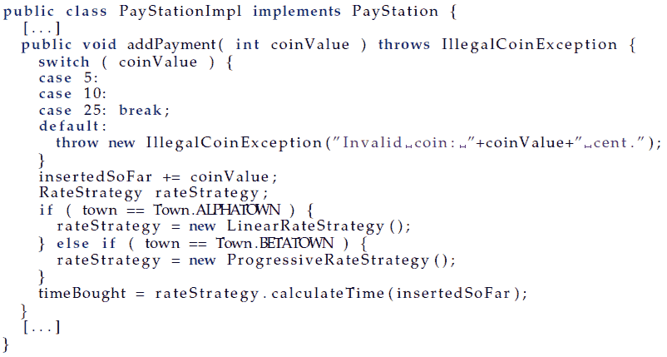
Concealed Parameterization
Assume: Previous binding survived.
Later: “Why does Betatown not work any more?
I need to fix it, and fix it fast!”
© Henrik Bærbak Christensen

Slide 15
Advice
Proverb:
Decide on a design strategy to handle a given variability and stick to it.
© Henrik Bærbak Christensen

Slide 16
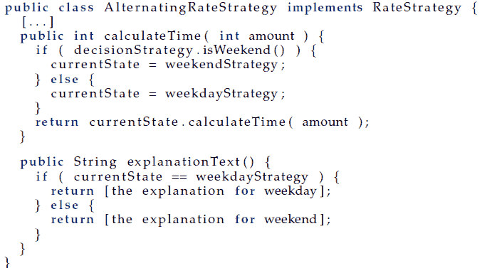
Responsibility Erosion
Software changes its own requirement.
New (weird) request
  Gammatown: Explain rate policy.
© Henrik Bærbak Christensen

Slide 17
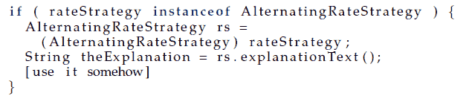
Consequences
Now, however, this strategy does not conform to the contract by the interface.
Solution: Move the method up into the RateStrategy interface.
But: I have now added a new responsibility. One that may not be very cohesive.
© Henrik Bærbak Christensen

Slide 18
Advice
Proverb:
Carefully analyse new requirements to avoid responsibility erosion and bloating interfaces with in-cohesive methods.
© Henrik Bærbak Christensen

Slide 19
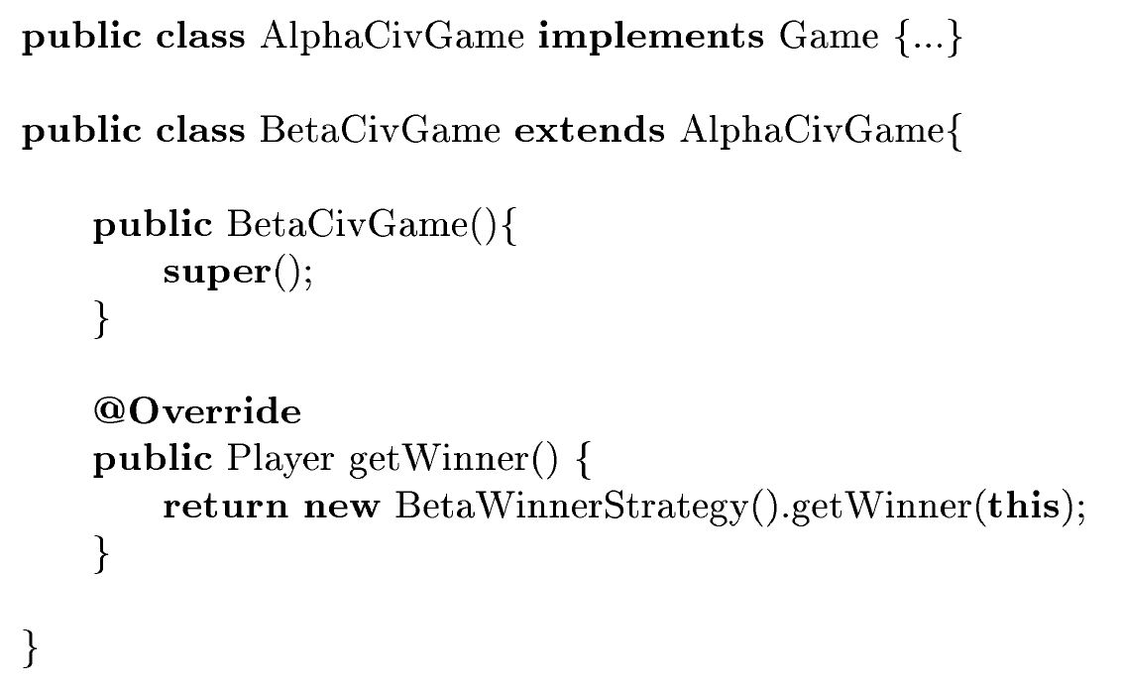
The polymorphic wrapping trap
From the mandatory hand-in
© Henrik Bærbak Christensen

Slide 20


Summary
Take care at the implementation level!!!
It only takes a few “slip-ups” to completely destroy the intended benefits of a pattern!
Corollary: You do not learn patterns by reading a book or listening to me!
CODE! and reflect!


© Henrik Bærbak Christensen

Slide 21
Summary
All your programmers must deeply understand the roles and protocols embodied in design patterns in order to keep the design intact.
© Henrik Bærbak Christensen

